Slide 1
Scalable Multimodel Deep Esemble Learning Framework for Mob Behavior Analysis
Previous 6 Month Report

Slide 2
JHU Crowd++ Dataset
JHU Crowd++ Dataset
Our Collected Dataset

Slide 3
JHU Crowd++ Dataset
A comprehensive dataset with 4,372 images and 1.51 million annotations.
In comparison to existing datasets, the proposed dataset is collected under a variety of diverse scenarios and environmental conditions.
In addition, the dataset provides comparatively richer set of annotations like dots, approximate bounding boxes, blur levels, etc.

Slide 4
JHU Crowd++ Dataset
4,372 images
Contains 4,372 images (with an avg resolution of 1430x910) collected under a diverse set of conditions and various geographical locations.
1.51 million annotations
Contains a total of 1.51 million dot annotations with an average of 346 dots per image and a maximum of 25K dots.
Diverse conditions
Specific care is taken to improve diversity of the dataset by including images under adverse weather and various illumination conditions.
Rich set of annotations
Provides head-level labels (dots, approx. bounding box, blur-level, etc.) and image-level labels (scene type and weather condition).

Slide 5
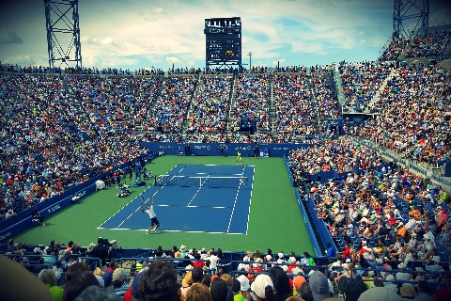
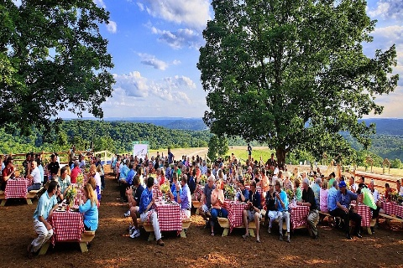
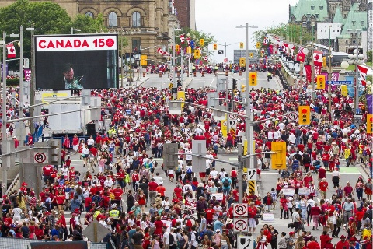
JHU Crowd++ Dataset (Diverse Conditions)
Low density
Medium Density
High Density

Slide 6
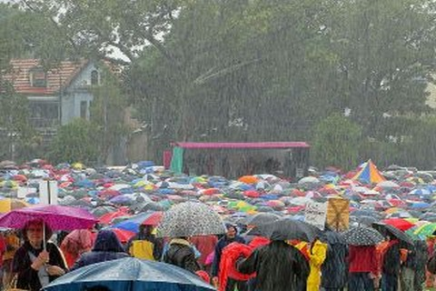
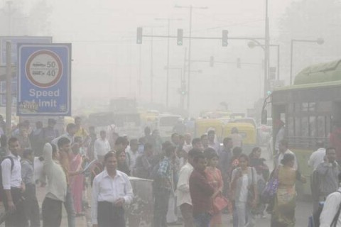
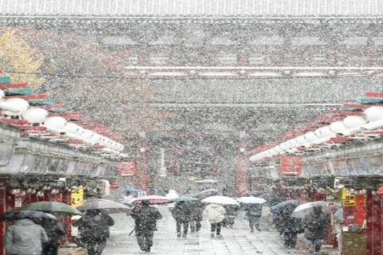
JHU Crowd++ Dataset (Diverse Conditions)
Snow
Rain
Fog

Slide 7
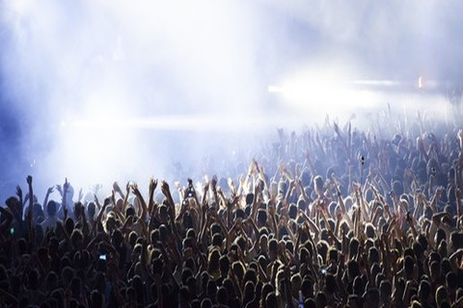
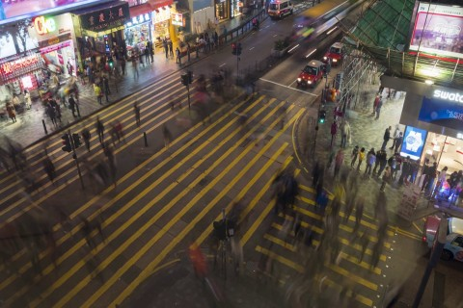
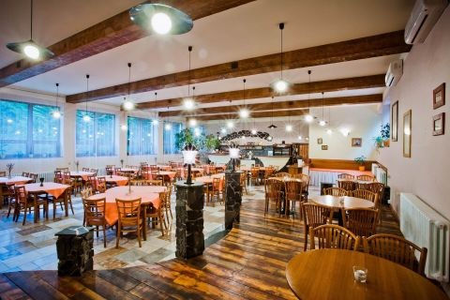
JHU Crowd++ Dataset (Diverse Conditions)
Low illumination
Night time
Distractor

Slide 8
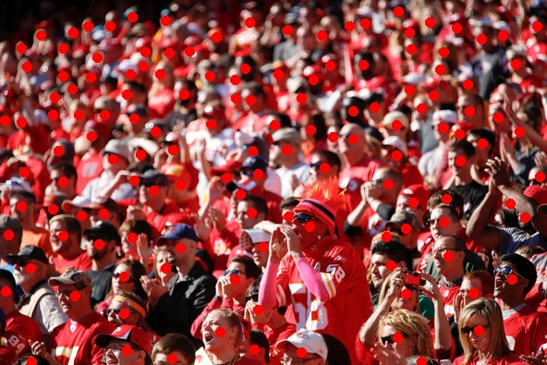
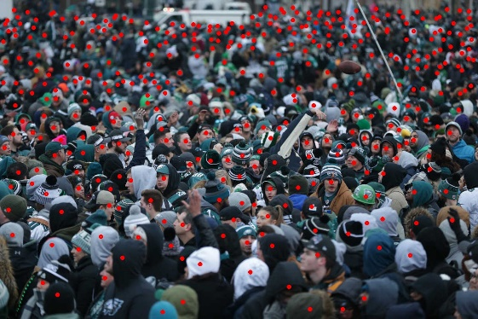
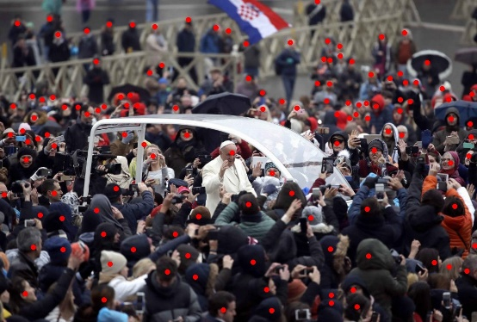
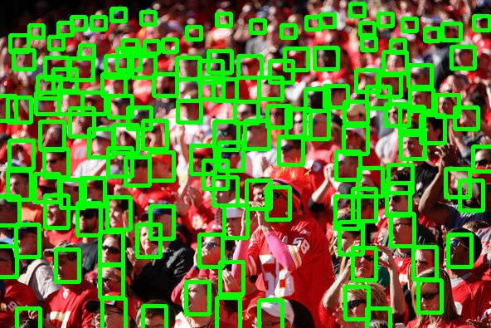
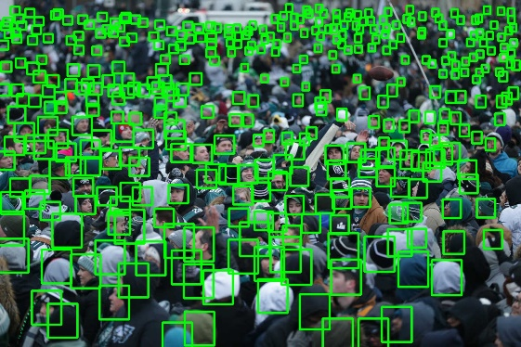
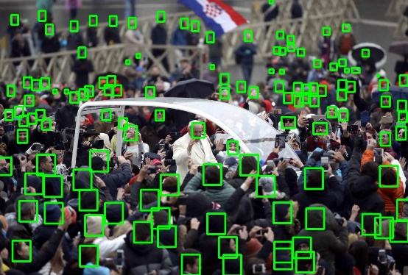
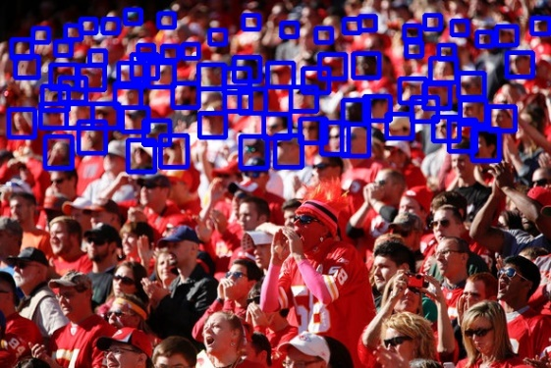
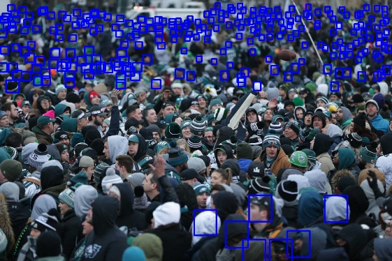
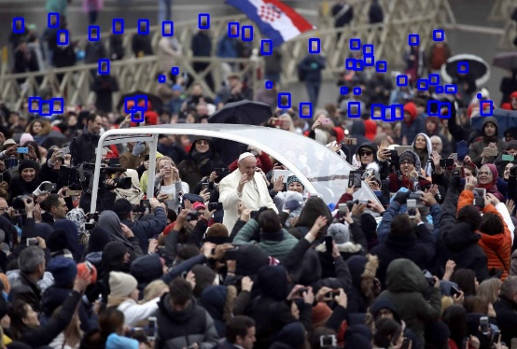
JHU Crowd++ Dataset (Annotation Highlights)
Dots
Bounding Box
Blur-level

Slide 9
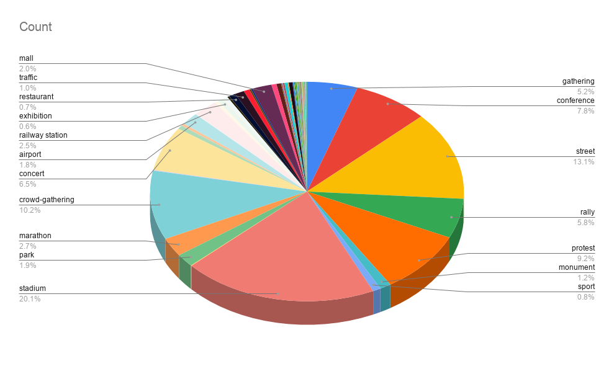
JHU Crowd++ Dataset (Statistics)
Distribution of image labels

Slide 10
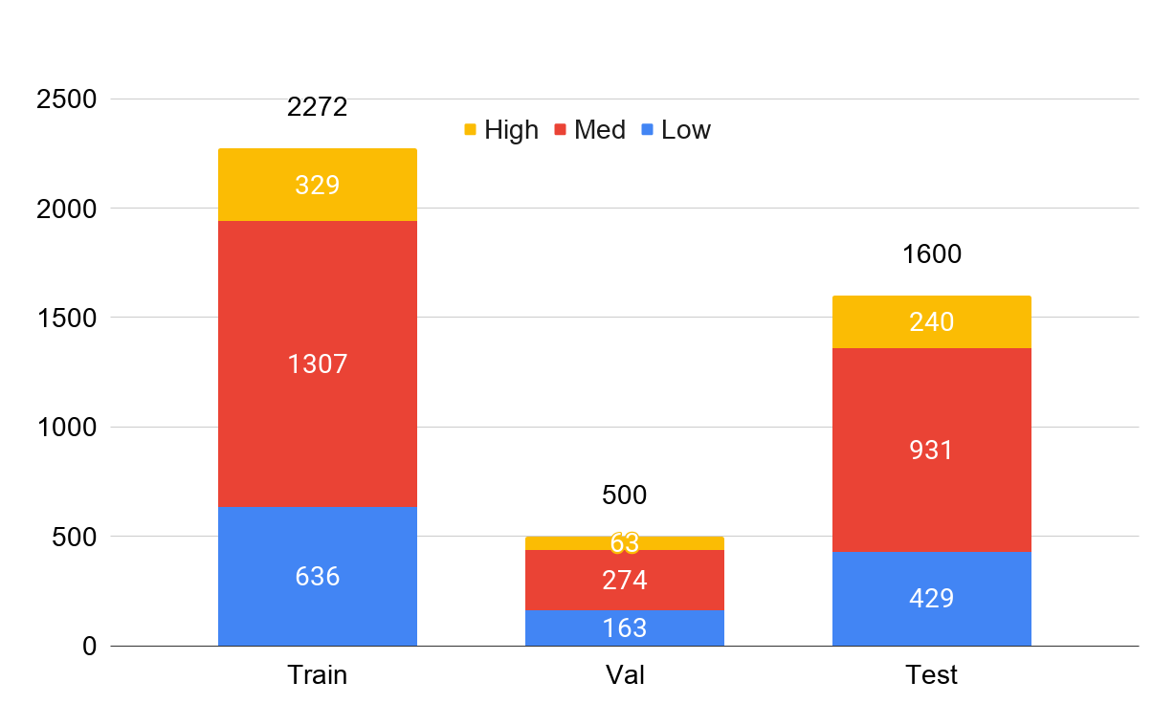
JHU Crowd++ Dataset (Statistics)
Distribution of different density images

Slide 11
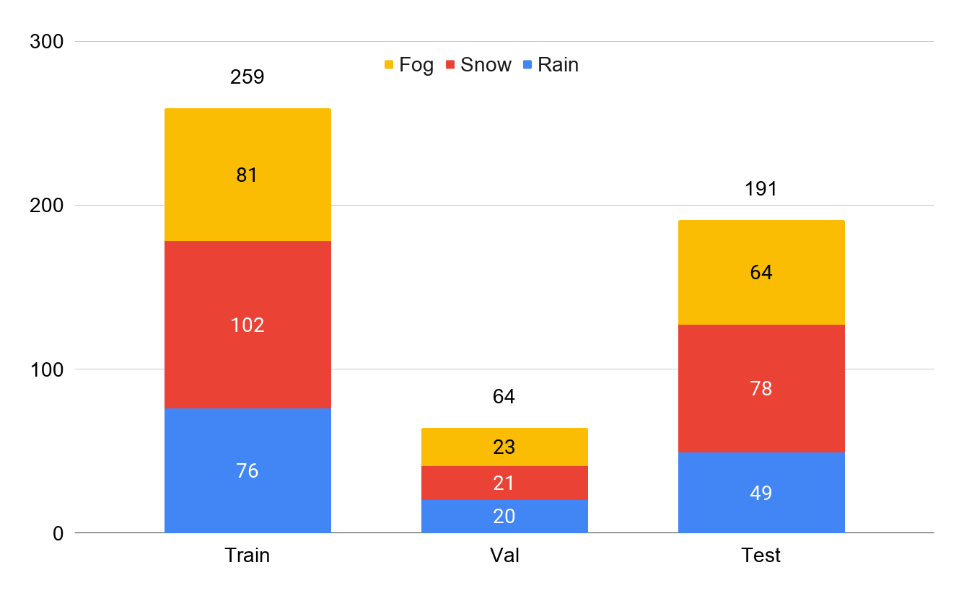
JHU Crowd++ Dataset (Statistics)
Distribution of weather-degradations

Slide 12
Our Collected Dataset
Dataset collected for detecting persons, playcards, and sticks to support crowd analysis.
Suitable for models in crowd detection, analysis, and safety monitoring.
We have collected dataset from publicly available, free resources from the internet

Slide 13
Our Collected Dataset (Scenarios)
Traffic Scenarios
Includes low, medium, and high traffic density scenes
Total Images: 1,230
Shopping Mall Scenarios
Captures low, medium, and high density crowd levels
Total Images: 1,470
Public Strike Scenarios
Contains images from low, medium, and high crowd intensity situations
Total Images: 720
Total Images: 3,420

Slide 14
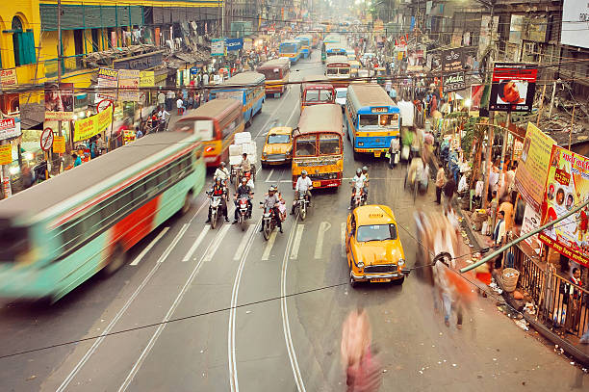
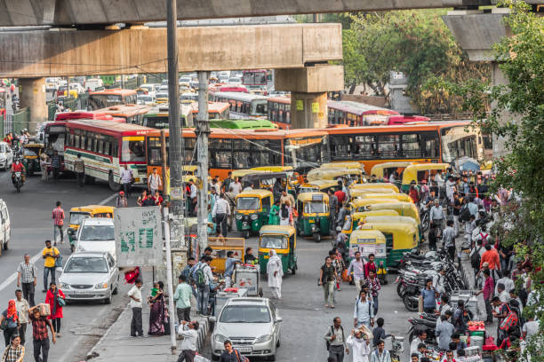
Our Collected Dataset (Diverse Conditions)
Low Traffic
Medium Traffic
High Traffic

Slide 15
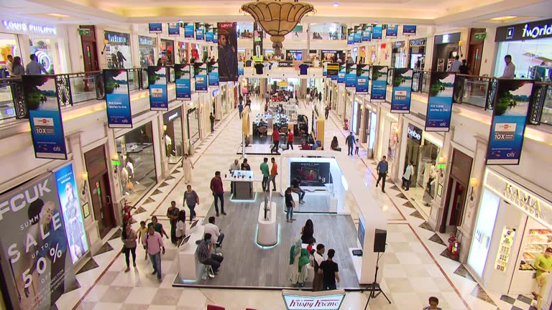
Our Collected Dataset (Diverse Conditions)
Low Density
Medium Density
High Density

Slide 16
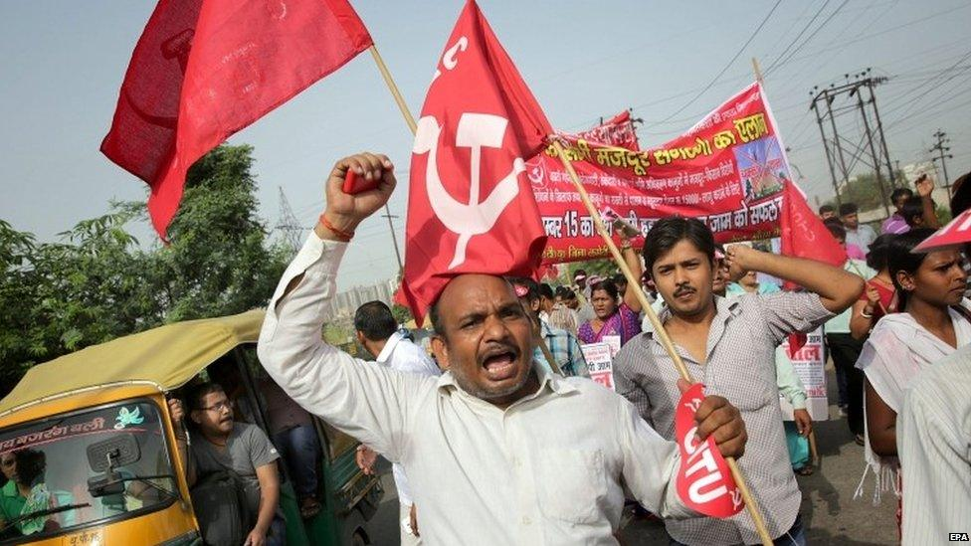
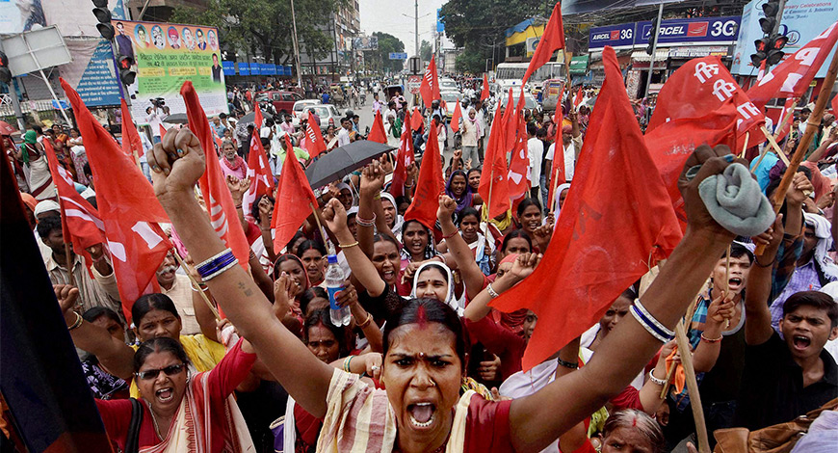
Our Collected Dataset (Diverse Conditions)
Low Density
Medium Density
High Density

Slide 17
Preprocessing of Dataset (Data Annotations)
Computers require context and annotations to interpret visual information and make informed decisions.
Data annotation is crucial for linking visual content like images, text, videos, and audio to enable deep learning models to understand and generate predictions.
Supervised learning methods, like the one used in this work, rely on labeled data for model training.

Slide 18
Our Collected Dataset (Annotation Process)
Tool Used: LabelImg software for image annotation
Classes Annotated:
Person
Playcard
Stick
Each image annotated with bounding boxes for the specified classes.

Slide 19
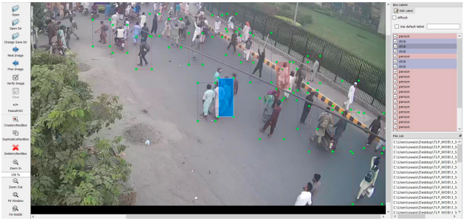
Our Collected Dataset (Annotation)
LabelIMG Annotation Tool

Slide 20
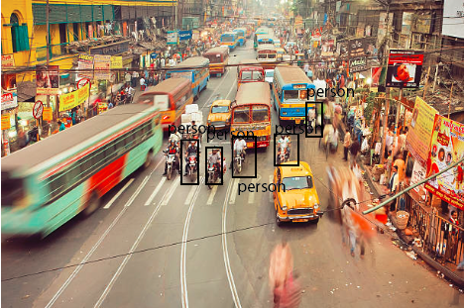
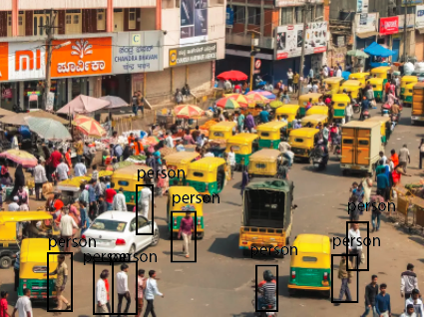
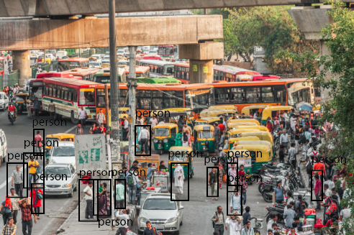
Our Collected Dataset (Annotated Images)
Low Traffic
Medium Traffic
High Traffic

Slide 21
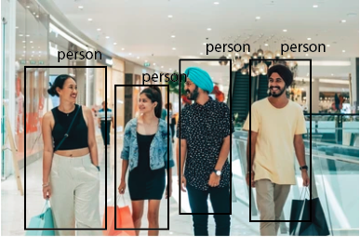
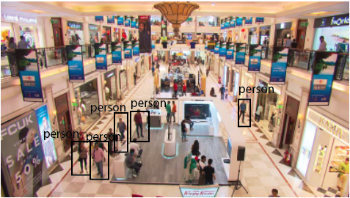
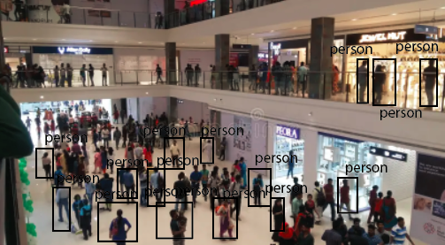
Our Collected Dataset (Annotated Images)
Low Density
Medium Density
High Density

Slide 22
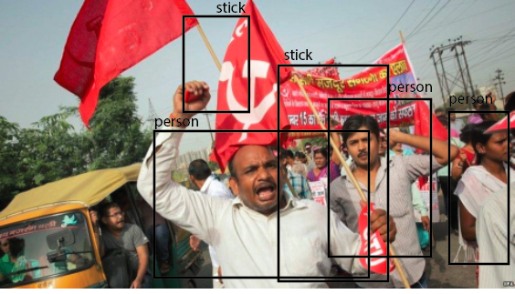
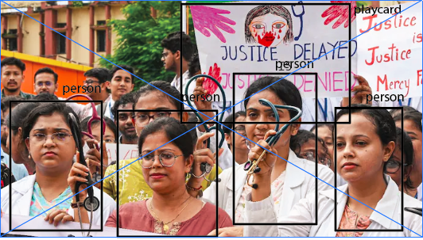
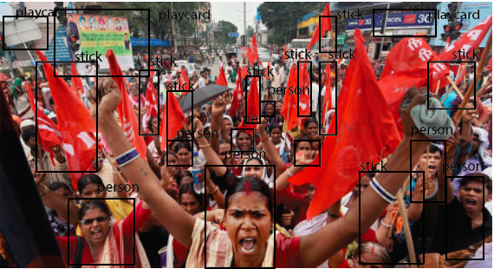
Our Collected Dataset (Annotated Images)
Low Density
Medium Density
High Density

Slide 23
Next 6 Month Plan
Training and optimization
Training and optimization of the each individual model and Task-specific fine-tuning to determine the final model
Multi-modality
Joining of individual models to make it multi-model crowd analytics system
Model Evaluation
Evaluation of individual model and joint multi-model on different performance metrics to determine the performance of each model and whole crowd analytics model
Thesis writing
Thesis writing and graphical illustrations

